Slide 1

Sequoro

Slide 2
TEAM MEMBERS
Anjana S
Ashly Chacko
Jithu R Jacob
Radhika P R

Slide 3
1. INTRODUCTION
Sequoro is an Open Authentication (OAuth) system with QR code based two step authentication
It provides free API access to all websites
It provides a new cost effective method for two step user authentication
It is resistant against several attacks including key loggers

Slide 4
2. PROBLEM DEFINITION
Existing system of OTP’s relies on an external devices , SMS or independent apps.
OTP’s send as SMS are prone to network delays, international roaming and are not accessible in areas with no network coverage.
They are costly for small companies to implement.
The proposed system helps us to solve these problems and provide us an economic and secure solution.

Slide 5
3. OBJECTIVES
Sequoro aims at providing an economical OAuth system to provide secure login to all websites
It must be secure against common password stealing attacks including key loggers

Slide 6
4. REQUIREMENTS
4.1 SOFTWARE REQUIREMENTS
Client Side : Android 4.3 or higher
Server Side : JSP
Browser : Google Chrome (recommended) or any other
4.2 HARDWARE REQUIREMENTS
Processor : 1 GHz or faster processor
Memory size : 1GB RAM or higher
Device : Android Mobile with 2 MP or higher

Slide 7
5. MODULES
REGISTRATION
Email address and password are collected from users and companies
Companies can enter their website details
User can select protocol and specify secondary password
APPLICATION CONFIGURATION
Verified user can only use the system
RSA 2048 bit key pair generation
Public key is uploaded to server
Private key is saved to local storage

Slide 8
QR CODE GENERATION
User is verified and protocol selected
For protocol 1 OTP is generated, encrypted and encoded to QR code
For protocol 2 random keyboard layout is created ,encrypted and encoded to QR code
LOGIN PROCEDURE
User is verified , QR code is generated and displayed
User scans the QR Code
For protocol 1 OTP is decoded from QR code, decrypted and displayed
For protocol 2 Keyboard layout is decoded from QR code ,decrypted and displayed

Slide 9
OPEN AUTHENTICATION
Users of a website are shown option to sign in using Sequoro
User would be prompted to enter his credentials
Two Step Authentication would be performed
Authenticated users would be redirected to website along with request code
Website authenticates the request code to obtain access code
Websites could access user details using access code

Slide 10
6. TWO STEP AUTH PROTOCOLS
Current two step authentication schemes works using SMS and TOTP apps
Sequoro uses a pair of new protocols using QR codes
We introduce two new protocols
Authentication with One Time Password (Protocol 1)
Authentication with Password and Randomized Onscreen Keyboard (Protocol 2)
Notes:
IN PROTOCOL 1 WE USE A SIMPLE OTP SYSTEM THE USR NEEDNOT REMEMBER A PWD
IN PROTOCOL 2 THE USR NEED TO REMEMBER A PWD AND THIS WOULD BE ENTERD USING A RANDOSD VIRT KEYBD

Slide 11
Protocol 1
User provides login credentials
Server verifies the details ,create an OTP and encrypt it with users public key
Server encode this into a QR code and sends to user along with a nonce
User needs to decrypt the OTP from QR code

Slide 12
Protocol 2
User provides login details
Server verifies the details ,create a random keyboard layout and encrypt it with users public key
Server encode this into a QR code and sends to user along with a nonce
User needs to decrypt the Layout from QR code
User uses this random layout to enter his secondary password

Slide 13
7.Sequoro OAUTH ARCHITECTURE
Sequoro OAuth consists of three phases
Phase 1 – Request Generation
User visits a website
Website sends a state request to Sequoro along with its Client ID and Client Secret Key
Sequoro provides a state code that acts as a CSRF token
The request URL is then formed using Client ID, Redirect URL and Timestamp and a nonce
The nonce is an HMAC of the other parameters using Client Secret Key
When user clicks login button request is send to this URL

Slide 14
Phase 2 – Authentication
Sequoro verifies the state and HMAC and invalid requests are rejected
Sequoro two step authentication is performed
If user has been authenticated a Request Code is send as reply
The client would be redirected to the website’s Redirect URL provided
Phase 3 – Obtaining user data
The website send a request along with the Request Code, Client ID and Client Secret Key
Sequoro validates the codes and returns an Access Code
It is used to access user details
The Access Code is used for future requests
The website could save the Access Code as a Session ID

Slide 15
BROWSER
WEBSITE
SEQUORO
1 USER VISIT WEBSITE
2 REQUEST STATE
PHASE 1
4 GENERATE REQUEST
3 STATE
1 SEQUORO LOGIN SELECTED
PHASE 2
2 REDIRECT TO SEQUORO LOGIN PAGE
1 SEQUORO AUTHENTICATION
PHASE 3
2 REDIRECT ALONG WITH REQUESTCODE
3 CALL REDIRECT URL
4 REQUEST ACCESSCODE
5 ACCESSCODE
6 REQUEST USERDATA
8 SHOW USERDATA
7 USERDATA

Slide 16
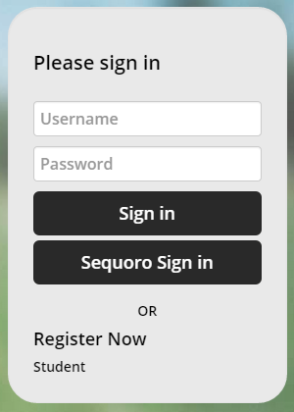

Slide 17
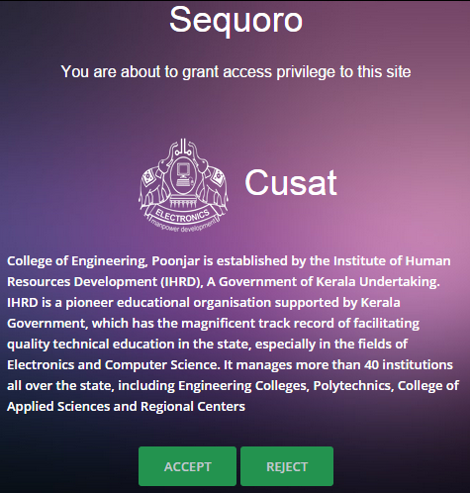
http://localhost:8080/site/api/login_api.jsp?clientid=K9VU/lMey/CCbACxgdf775sGltA=&redirecturl=http://localhost:8080/cusat/login_check.jsp&time=2015-03-15%2014:49:36.618& state=e254a1ef1c5c34c2df73814d99bbb87dcebfc4e0&nonce=CB3ZK47MLmD0S9yzrDl4vzDUXcgPAOBL03MioARe6uE%3D

Slide 18
8. DATA FLOW DIAGRAM
LEVEL 0
SEQUORO
USER
REQUEST
RESPONSE
USER

Slide 19
LEVEL 1
CMPNYOPNS
2.0
REGISTERD COMPANY
CHECK
USER
1.0
USER
OPNS
3.0
REGISTRD USER
INFO
USER
NOT REGISTERED
EXTERNAL LOGIN
REGISTR
4.0
CHECK LOGIN
5.0

Slide 20
LEVEL 2 DFD FOR PROCESS 2.0
CMPNY OPNS
ADD SITE
COMPANY
INFO
SITE URL
WEBSITE DETAILS

Slide 21
LEVEL 2 DFD FOR PROCESS 3.0
FORGT PASWD
3.1
FORGOT PWD
USER OPNS
APP
CONFG
3.2
USER
INFO
APP CONFIG
PROTOCOL
PROTCL SELCTN3.3
SELECT PRTCOL
SELECT
USER DETAILS

Slide 22
LEVEL 2 DFD PROCESS 4.0
CMPNY
COMPNY DETAILS
USERNAME,EMAIL,PWD
REGISTR
USER
INFO
USERNAME,EMAIL,PWD
USER
USER DETAILS

Slide 23
OTP DETAILS
LEVEL 2 DFD PROCESS 5.0
LOGIN PRCD 1 5.1
GENRTE QR CODE
LOGIN
PROTCL 1
EXTERNL LOGIN
USER
USERNAME,PWD
PROTCL 2
GNRT QR, RANDM KYBD
LOGIN PRCD 2 5.2
LOGIN
USER DETAILS
OTP DETAILS

Slide 24
LEVEL 3 DFD FOR PROCESS 3.1
FORGT PASW
SEND RECVRY MAIL
USER
INFO
HASH(RAND)
EMAIL,HASH(RAND)
USER DETAILS

Slide 25
LEVEL 3 DFD FOR PROCESS 3.2
APP CONFG
GENRT RSA KEY PAIR
USER
USERNME, PASW
VERIFIED
PRIVATE KEY
LOCAL STORAGE
VERIFY
PUBLIC KEY
USER DETAILS
USER DETAILS

Slide 26
LEVEL 3 DFD FOR PROCESS 5.1
SHOW QR CODE
DECDE
DECRPT AND SHOW OTP
AUTH
USER
VERIFIED
SCAN QR
SHA1(OTP)
QRENCODE(RSA(OTP))
PRIVATE KEY
SHA1(OTP)
OTP
LOCAL STORAGE
OTP

Slide 27
LEVEL 3 DFD FOR PROCESS 5.2
SHOW QR CODE
DECDE
DECRPT AND SHOW KYBD
AUTH
USER
VERIFIED
SCAN QR
KEYS
QRENCODE(RSA(KEYBD))
PRIVATE KEY
SHA1(SPWD)
OTP
LOCAL STORAGE
USER DETAILS

Slide 28
USER DETAILS
9.DATABASE DESIGN
ATTRIBUTE | TYPE | CONSTRAINTS
Id | int | Auto increment
name | varchar(60) | Not null
password | varchar(50) | Not null
email | varchar(150) | Not null
verified | int | Default 0
public_key | varchar(500) | Null
keyhash | varchar(50) | Null
protocol | int | Default 0
secondary_password | varchar(30) | Null
isSiteOwner | int | Default 0

Slide 29
OTP DETAILS
ATTRIBUTE | TYPE | CONSTRAINTS
id | int | Auto increment
email | varchar(150) | Not null
client_id | varchar(50) | Not null
otp_hash | varchar(50) | Null
time | timestamp | Default CURRENT_TIMESTAMP
used | int | Default 0
accesscode | varchar(150) | Not null
secure_otp_hash_id | varchar(150) | Null
protocol | int | Default 0
keyboard_layout | varchar(200) | Null

Slide 30
WEBSITE DETAILS
ATTRIBUTE | TYPE | CONSTRAINTS
id | int | Auto increment
owner_email | varchar(150) | Not null
site_name | varchar(100) | Not null
site_url | varchar(100) | Not null
site_redirecturl | varchar(200) | Not null
site_logo | varchar(300) | Not null
site_desc | varchar(500) | Not null
client_secretkey | varchar(150) | Not null
client_id | varchar(150) | Not null

Slide 31
API REQUEST DETAILS
ATTRIBUTE | TYPE | CONSTRAINTS
id | int | Auto increment
state | varchar(100) | Not null
requestcode | varchar(100) | Not null
accesscode | varchar(100) | Not null
clientid | varchar(100) | Not null
time | timestamp | Default CURRENT_TIMESTAMP
used | int | Default 0

Slide 32
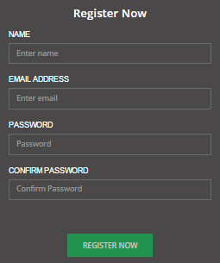
10. SCREENSHOTS

Slide 33
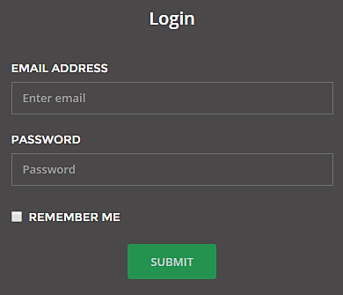

Slide 34
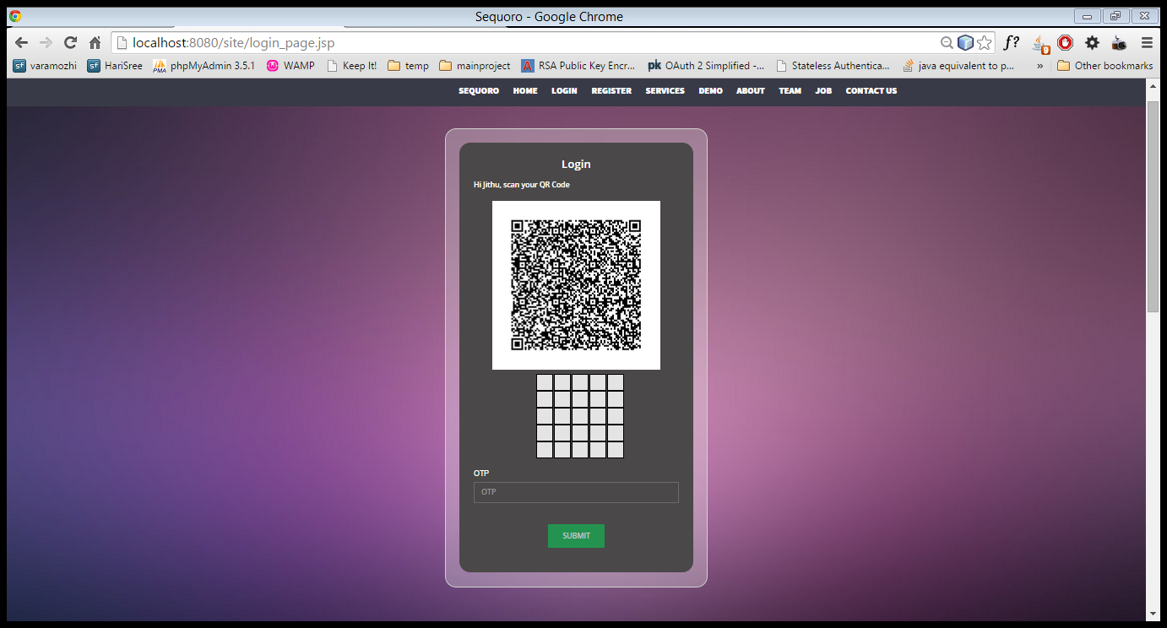
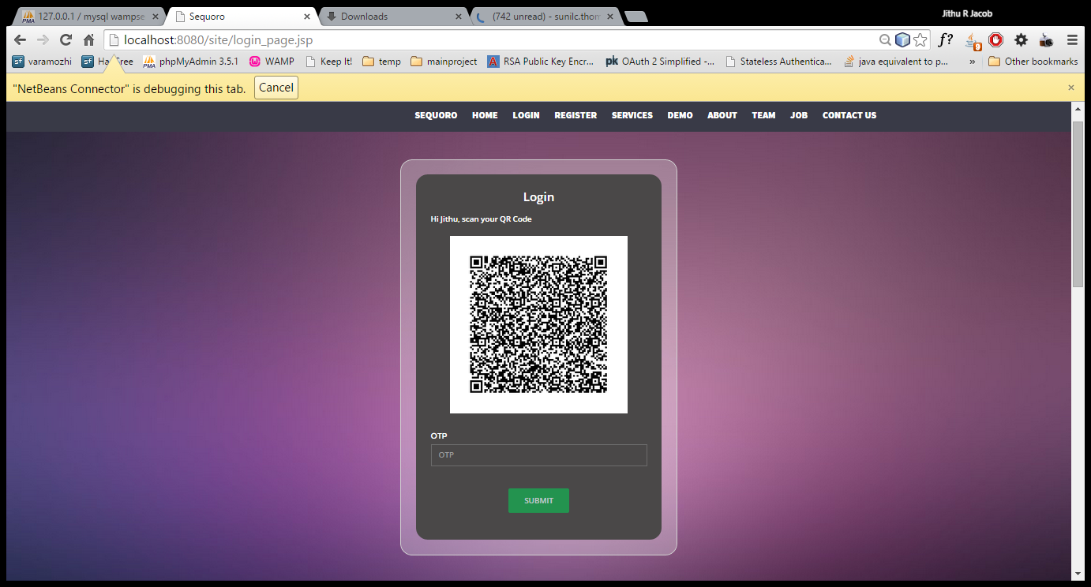

Slide 35
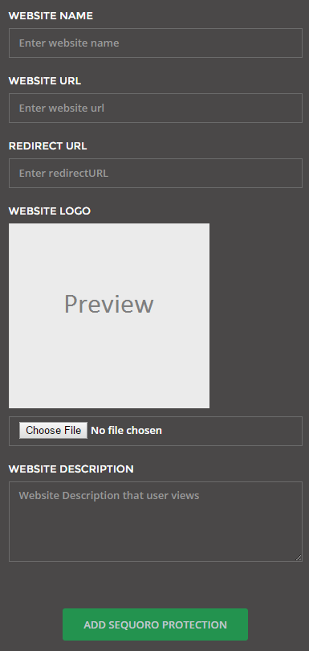

Slide 36
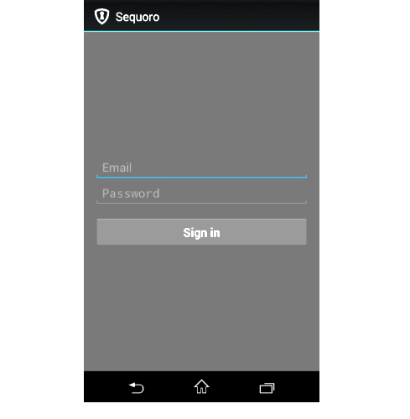
ANDROID APP INTERFACE

Slide 37
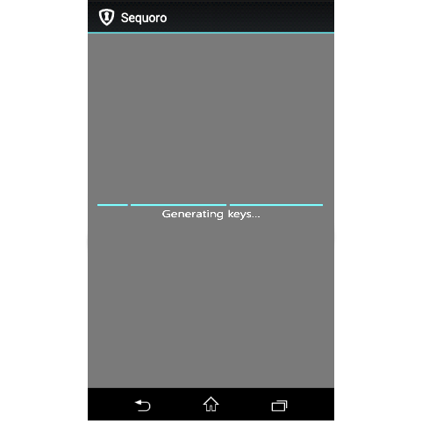

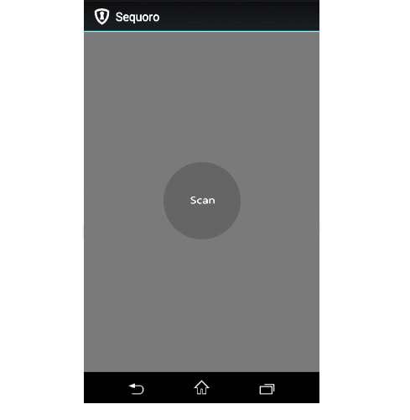

Slide 38
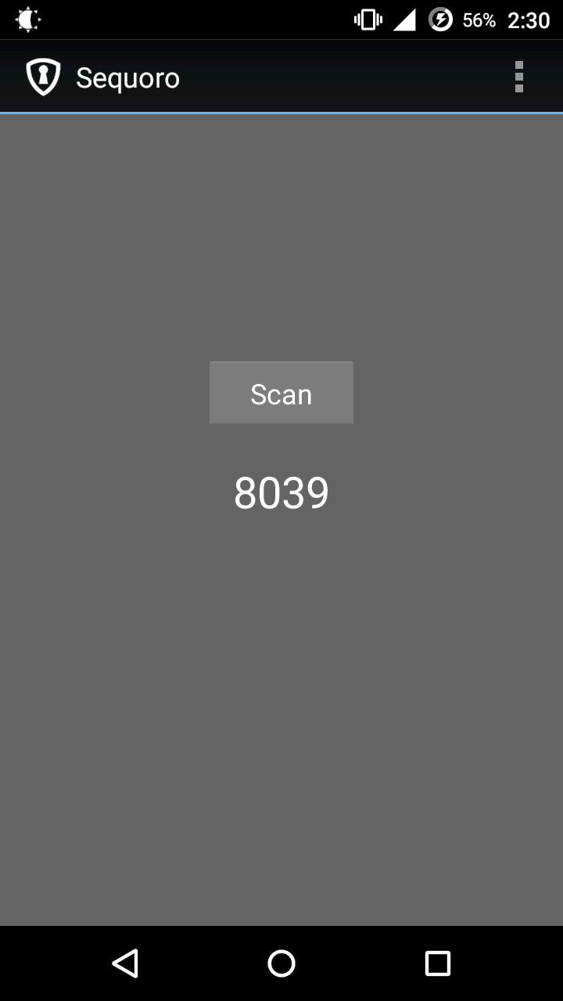
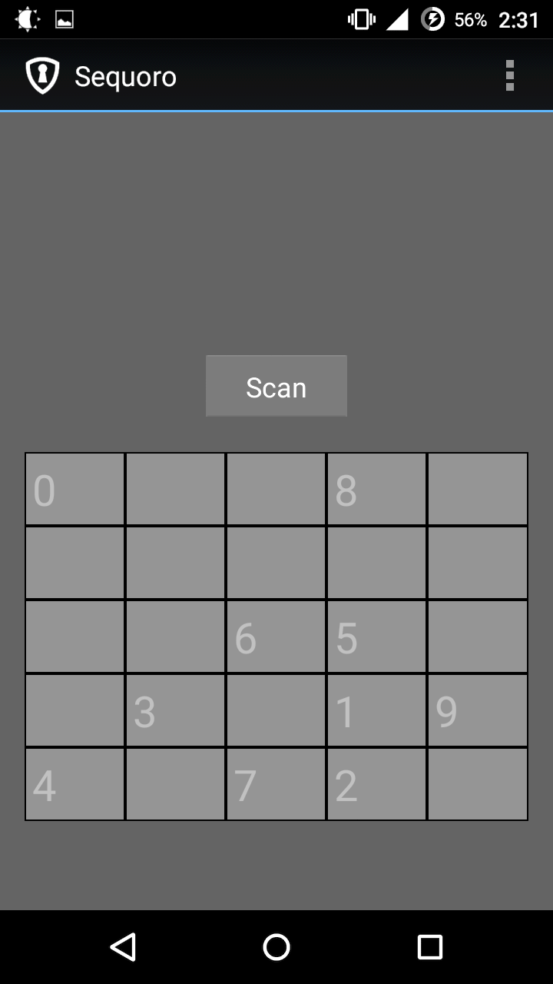
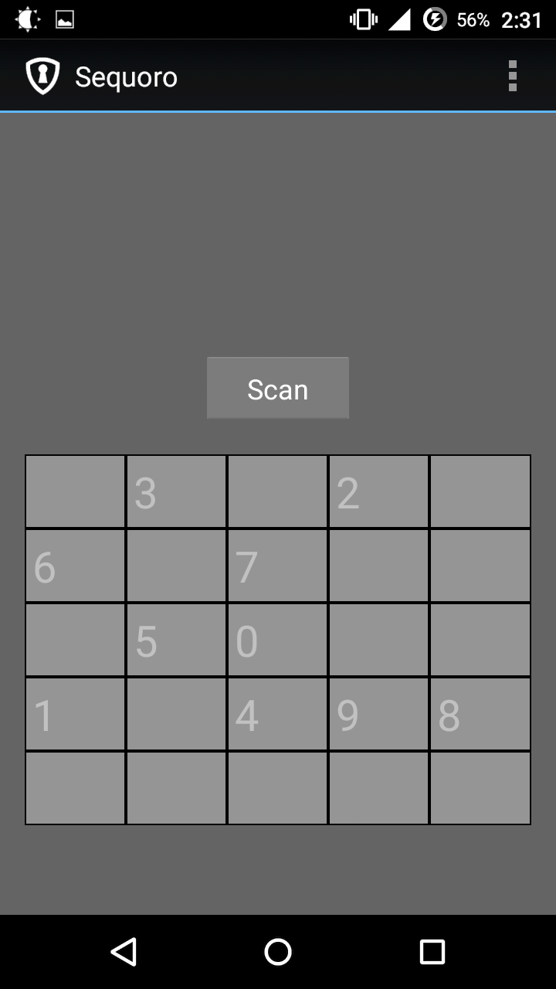

Slide 39
11.SYSTEM IMPLEMENTATION
Tools used
QR Code encoding and decoding – ZXing Library
Base 64 encoding and decoding – Apache Common Codecs
JSON encoding and decoding – Simple JSON Library
Development Environment - Windows
Android Development – Android Studio 1.0.2
JSP Development – NetBeans IDE 8.0.2
Server – Glassfish Server 4.1
Database – MySQL 5.6.17
Runtime Environment – Jelastic PaaS
Android – 5.0.2 Lollipop
Server – Glassfish 4.1
Database – MySQL 5.6.17

Slide 40
12. CONCLUSION
Sequoro provides a universal and economic solution for secure login to websites
It is secure against common password stealing attacks including key loggers.
Sequoro does not need any network coverage except for registration
By the use of cryptographic techniques passwords are saved securely.

Slide 41
13.REFERENCES
Key logging-resistant Visual Authentication Protocols ; Transactions On Mobile Computing, Vol. 1, No. 8, August 2014
ZXing. http://code.google.com/p/zxing/, 2011.
Google authenticator. http://code.google.com/p/google- authenticator/.
Rsa securid. http://www.emc.com/security/rsa-securid.html
Google. Android. http://www.android.com/, 2011.
S. Josefsson. RFC 4648: the base16, base32, and base64 data encodings.
OAuth , http://oauth.net/core/1.0/

Slide 42
Thank You

